Slide 1
DATA SCIENCE FUNDAMETAL
HOUSE PRICE PEDICTION
PRESENTED BY :
S.VELVIZHI
B Tech Agricultural Engineering
Sri Jayaram Institute Of Engineering
And Technology.

Slide 2
AGENDA
Objective
Introduction
Dataset
Categorical Attributes
Quantitative Attributes
Dataset Type
Data Visualization
Conclusion

Slide 3
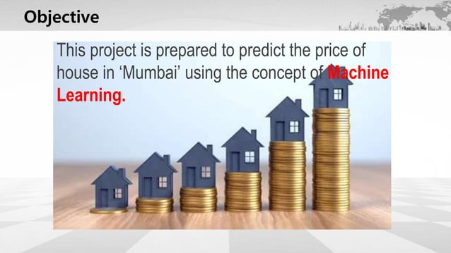

Slide 4
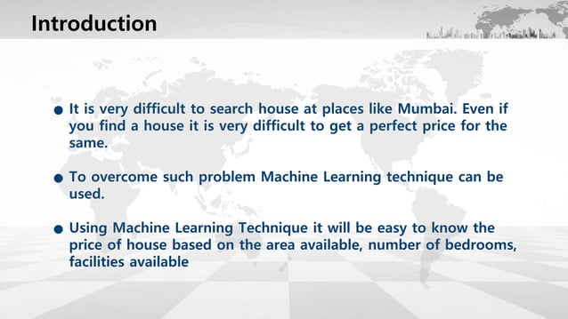

Slide 5
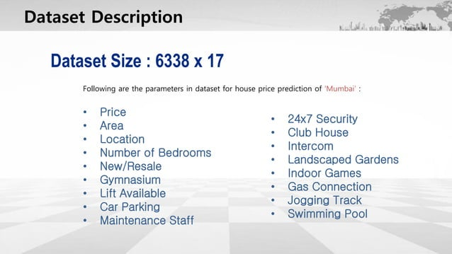

Slide 6
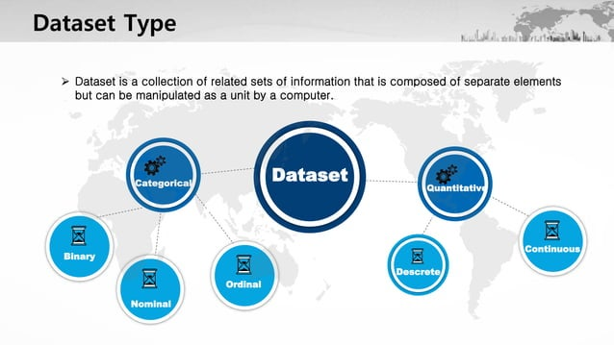

Slide 7
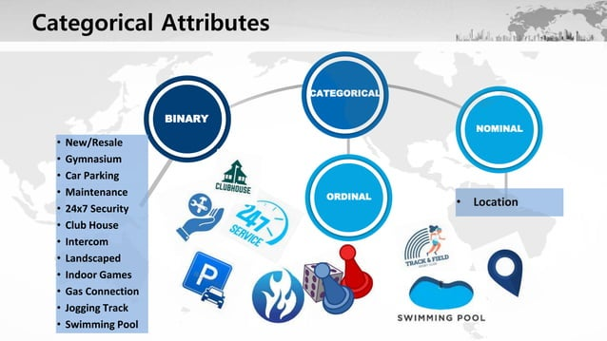

Slide 8
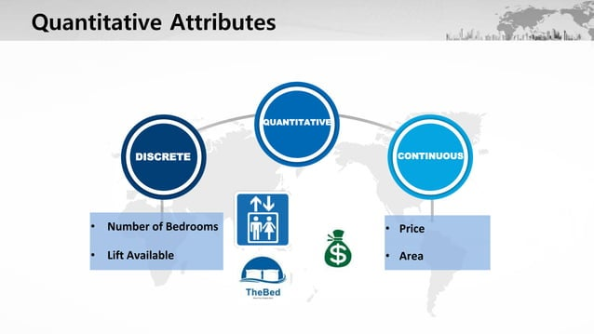

Slide 9
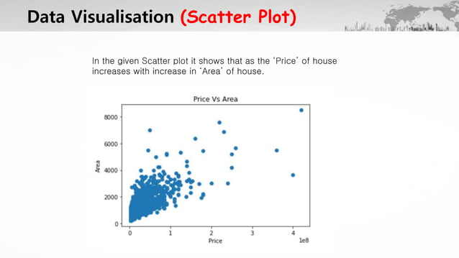

Slide 10
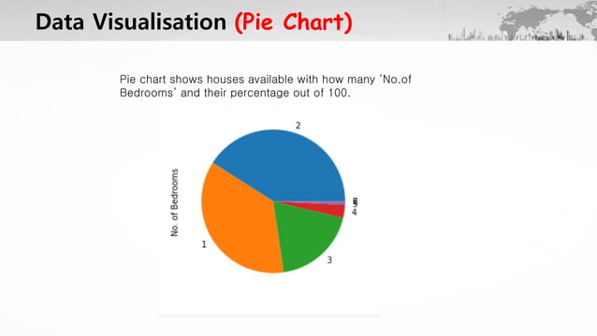

Slide 11
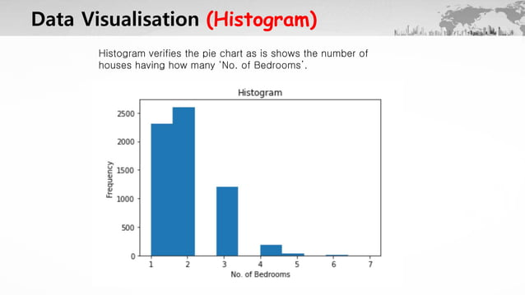

Slide 12
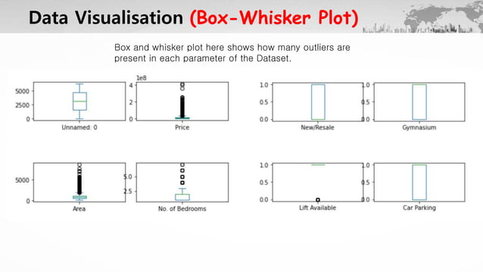

Slide 13
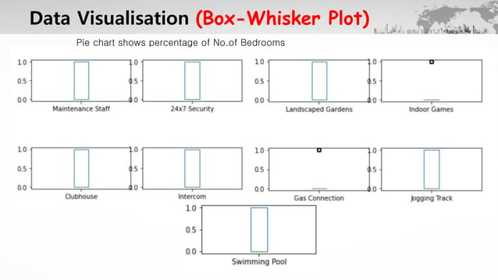

Slide 14
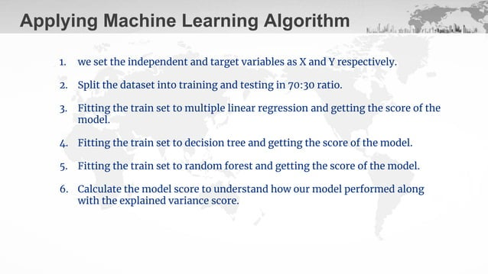

Slide 15
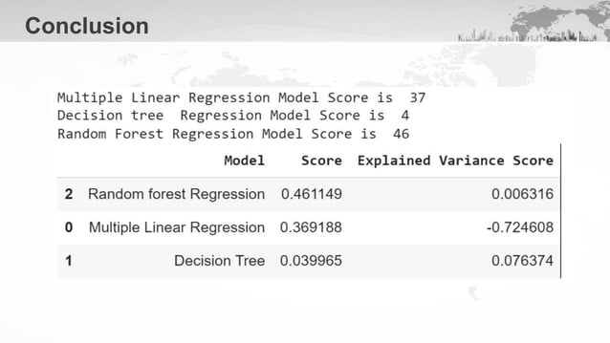

Slide 16
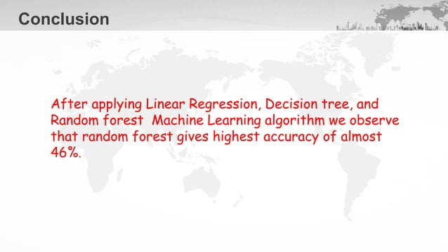

Slide 17


